Slide 1






Slide 2




Slide 4


Slide 5


Slide 6
Costs
4 L.E + price of patrol

Slide 7
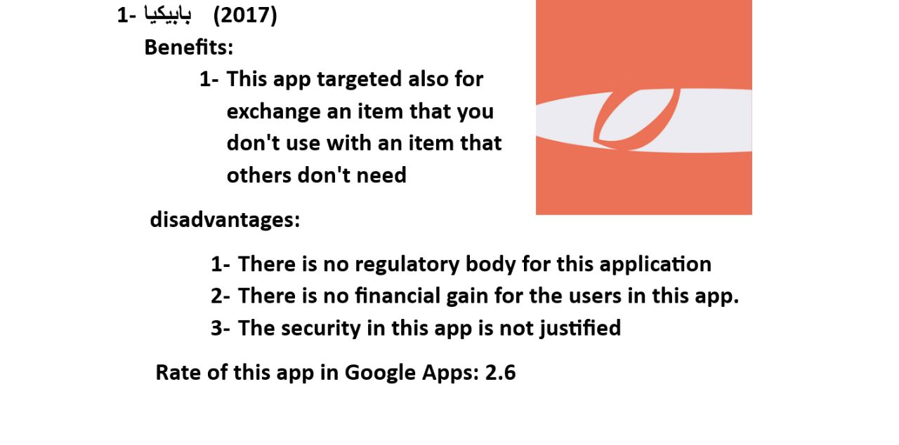

Slide 8

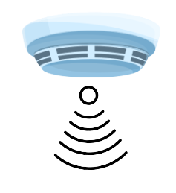




Slide 9
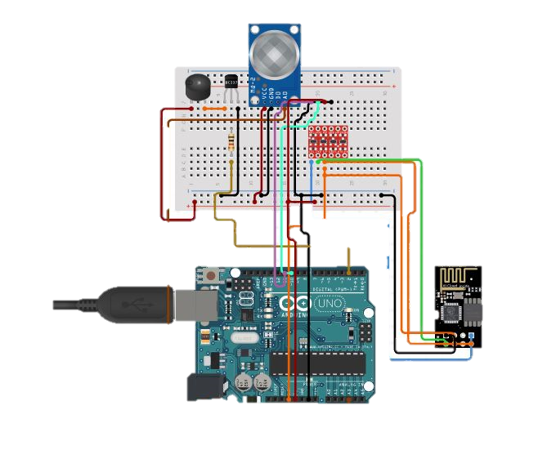

Slide 10


Slide 11
Costs
500L.E
FOR SECURITY AND WEIGHT SENSOR W. APP

